Slide 1
War and Independence
Part 1
Lexington and Concord

Slide 2
ABC Brainstorming
Write down specific words or phrases that begin with each letter about how the colonists were feeling around the time of the First Continental Congress

Slide 3
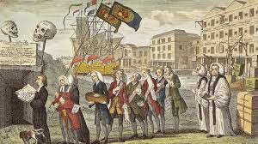
Why were many colonists feeling the way you described?
Many colonists felt their freedoms and rights were being taken away.

Slide 4
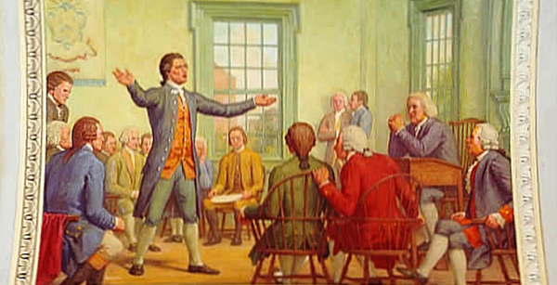
To try and deal with the increasing problems with Great Britain, delegates from 12 colonies met to discuss what to do. This became known as the First Continental Congress.

Slide 5
The delegates decided on the following:
-Stop trade with Britain.
-Send a list of their concerns to the king.
-Organize militias.
-Hold a second meeting if the king refused to make changes.

Slide 6
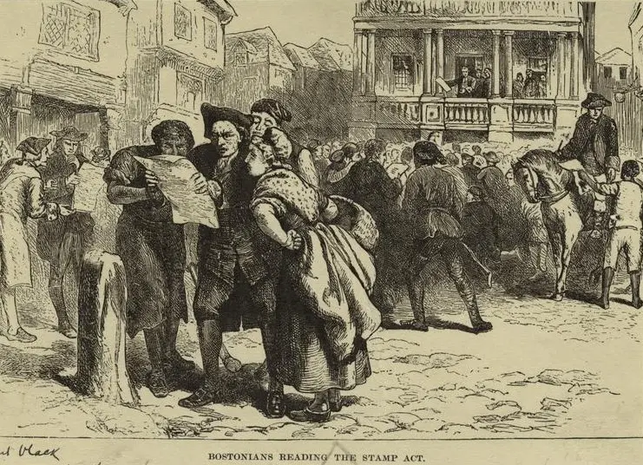
Many colonists expected that ending trade with Great Britain would force Parliament to end the Intolerable Acts.

Slide 7
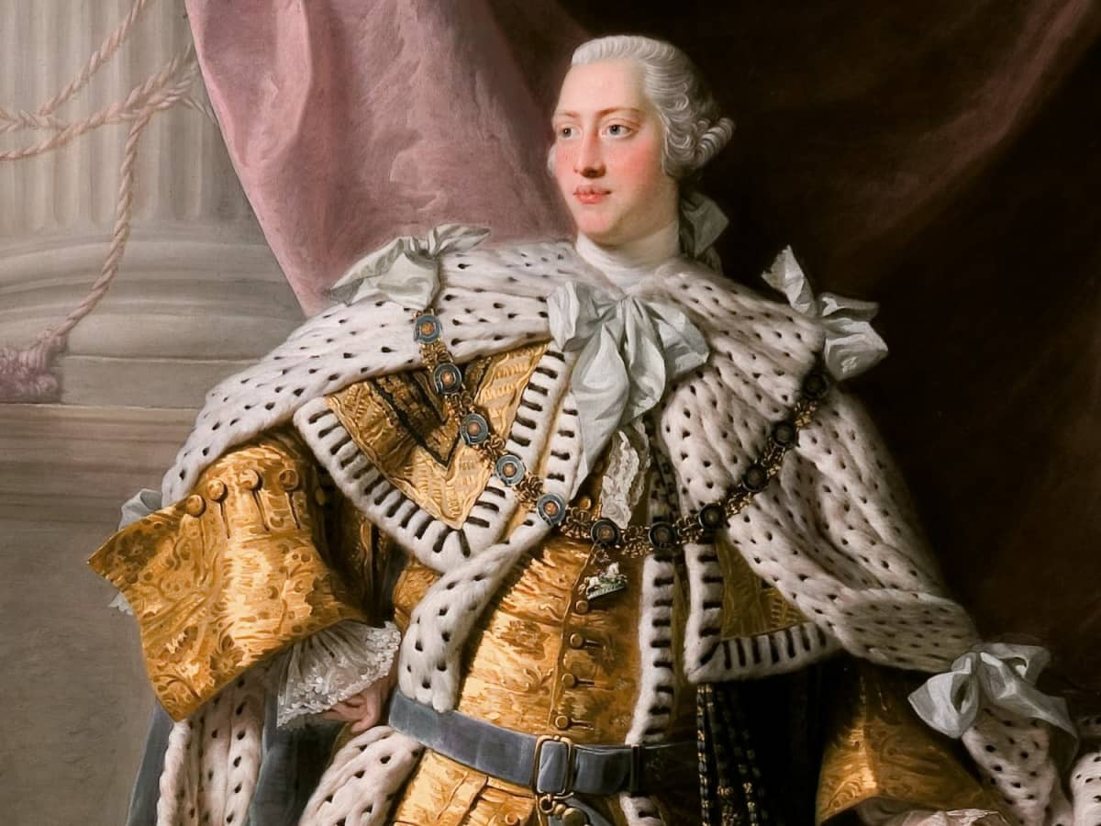
King George III and Parliament did not listen to the protests of the colonists. Instead, it added new limits on colonial trade and sent more soldiers to the colonies.

Slide 8
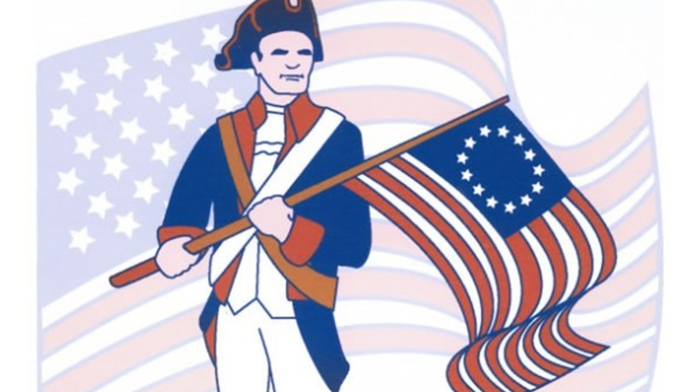
More and more colonists wanted independence. These people were called Patriots.

Slide 9
There were still some colonists that wanted to stay under British rule. They were called Loyalists or Tories.

Slide 10
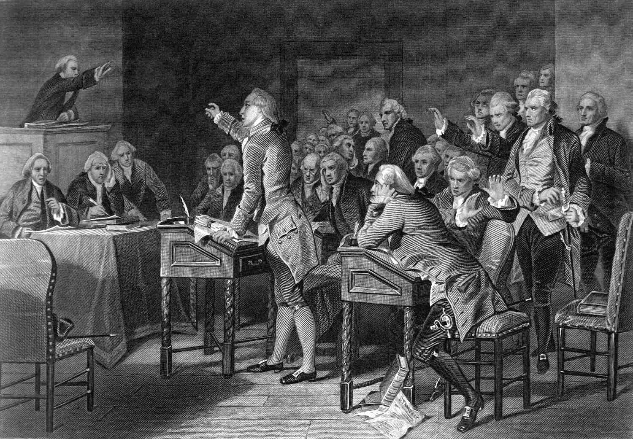
Committees of Safety were formed in many communities. These were local groups made up of Patriots that eventually replaced colonial governments set up by the British.

Slide 11
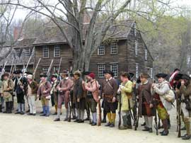
The First Continental Congress decided that communities should organize militias. These militiamen were often called minutemen because they could be ready to fight in a “minute”.

Slide 12
Think About It!
What do soldiers need to fight?

Slide 13
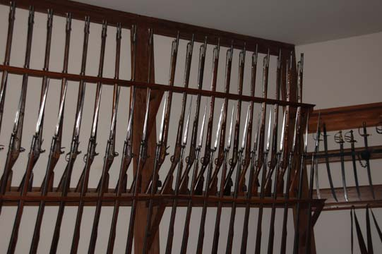
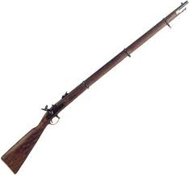
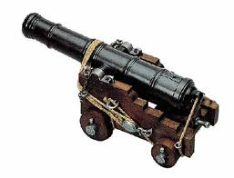
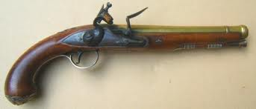
These militias needed weapons to fight, so they started secretly collecting and hiding their weapons from the British.

Slide 14
What Do You Think?
During this time period, it was very hard to keep secrets in the colonies.
Why do you think that was the case?

Slide 15
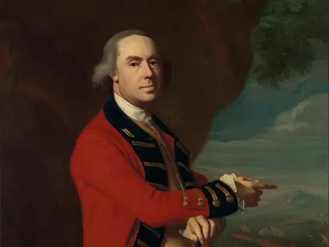
General Gage in Boston learned of weapons being stored by patriots in the town of Concord. He decided to have them seized.

Slide 16
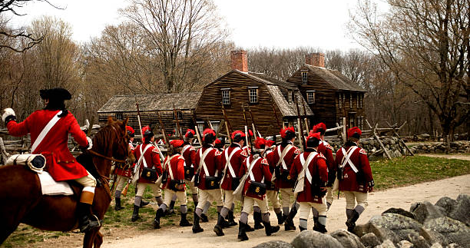
In the early morning hours of April 19, 1775, seven hundred elite British soldiers were to secretly row across the Charles River from Boston and march 18 miles to Concord and capture the Patriot’s weapons.

Slide 17
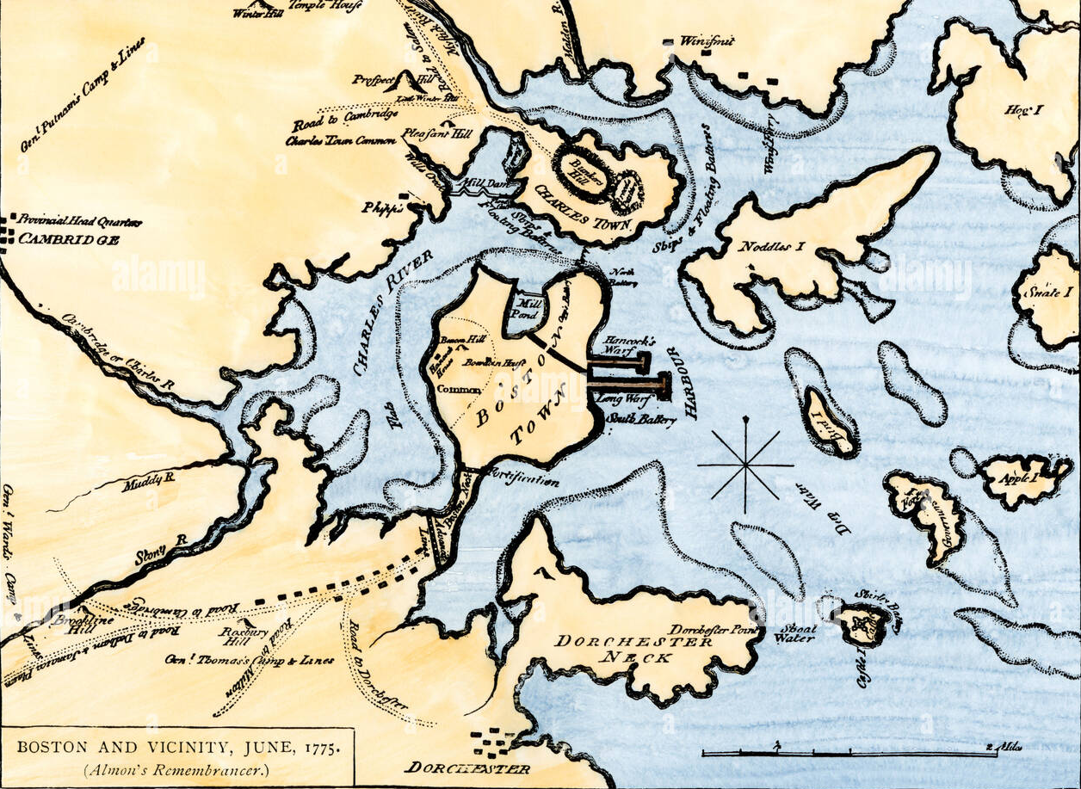

Slide 18
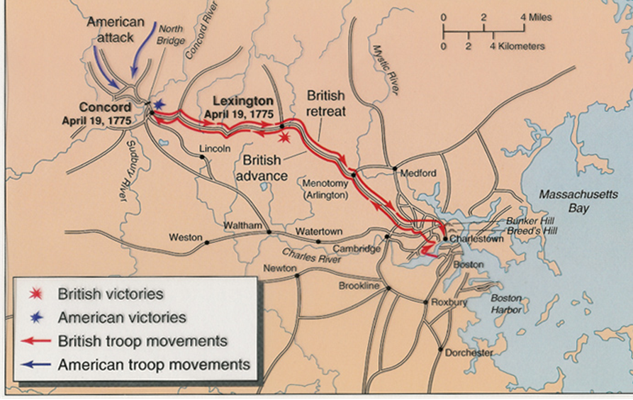

Slide 19
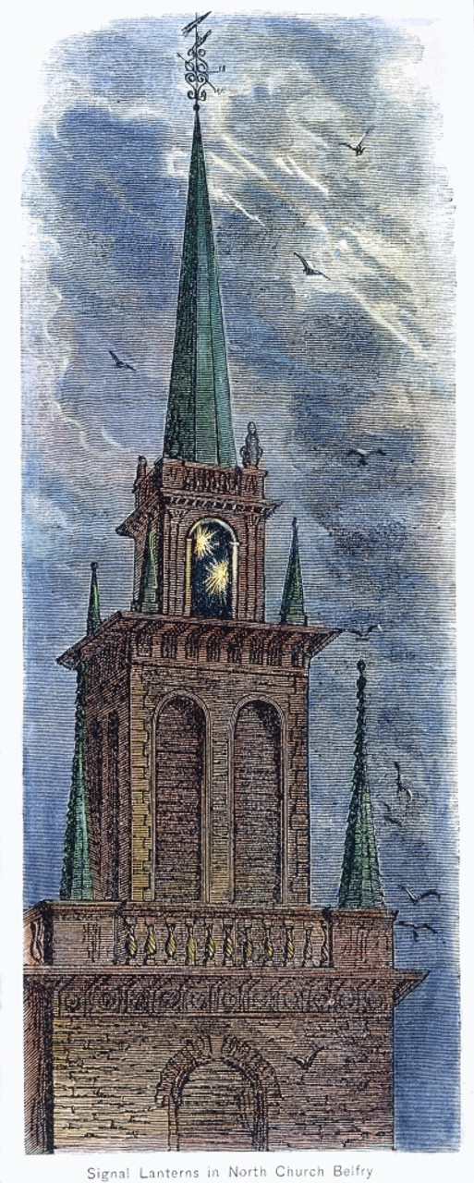
The Sons of Liberty had a spy network set up to watch the British soldiers. When they found out what the British were planning, they needed to let the local militias know.

Slide 20
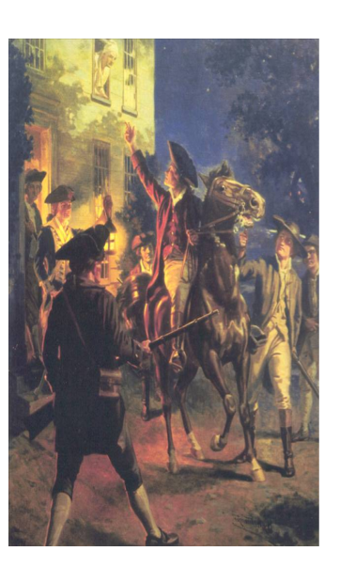
Paul Revere, William Dawes, and Samuel Prescott warned the people that the British were on their way to Concord.

Slide 21
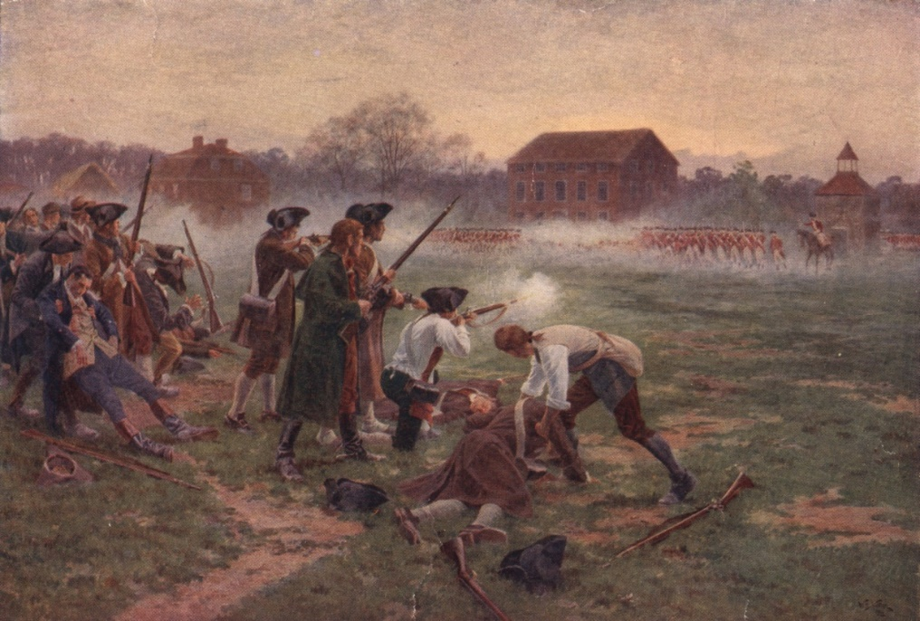
Patriots gathered in the town of Lexington to stop the British. A small battle took place. The British easily beat the militia.

Slide 22
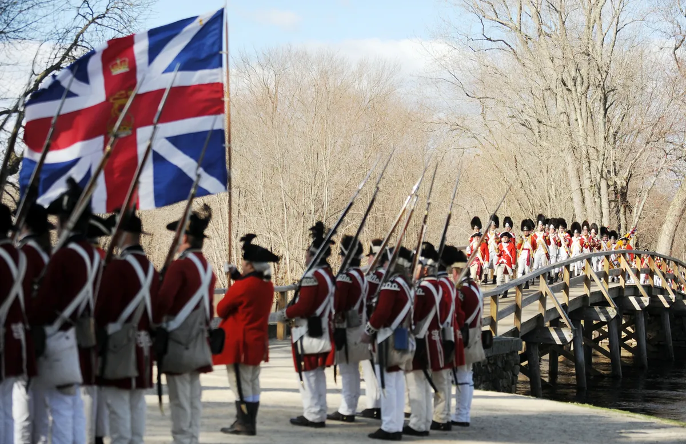
The British marched on to Concord. Once there, they searched for the hidden weapons, but most of the weapons had been moved.

Slide 23
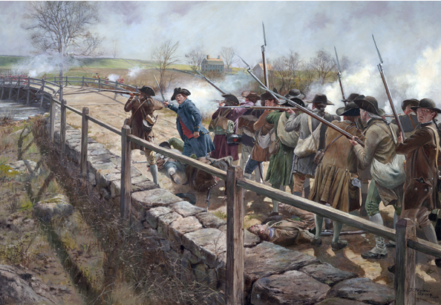
More minutemen gathered and attacked the British at Concord. The first shots fired are known as the “shot heard around the world.”

Slide 24
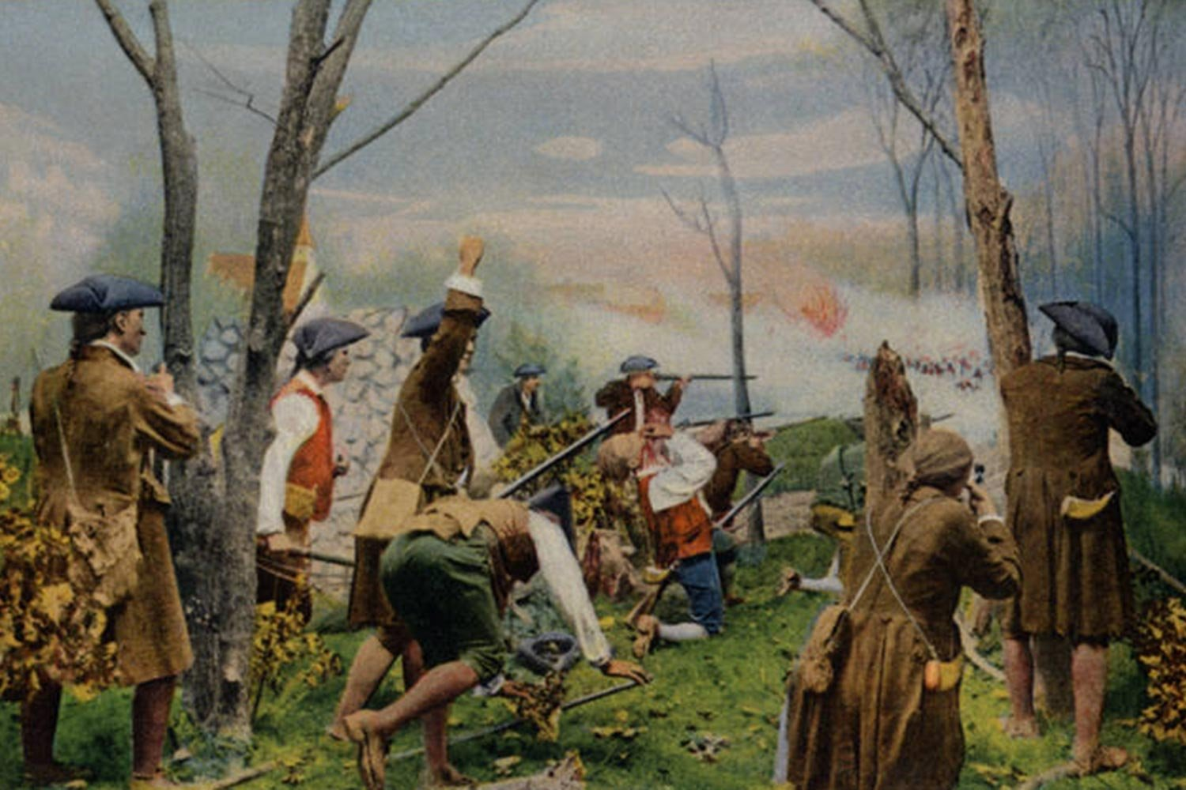
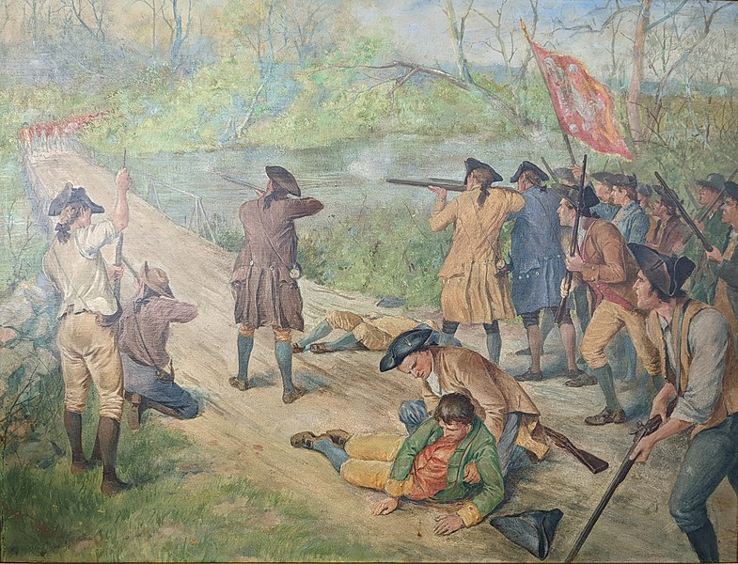
As the British retreated back to Boston along what is now called Battle Road, they are shot at and harassed by the almost 4,000 Minutemen who answered the call to fight.

Slide 25
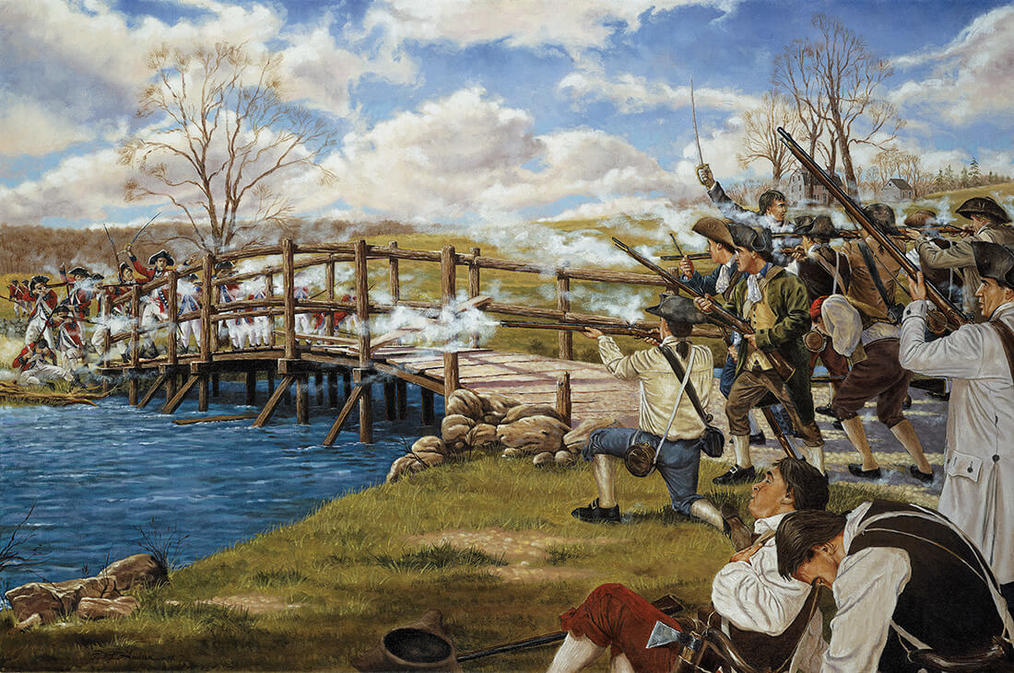
This victory encouraged the Patriots but enraged the British. The Revolutionary War had begun!

Slide 26
Exit Question
Do you think violence could have been avoided? Why or why not?

